Slide 1

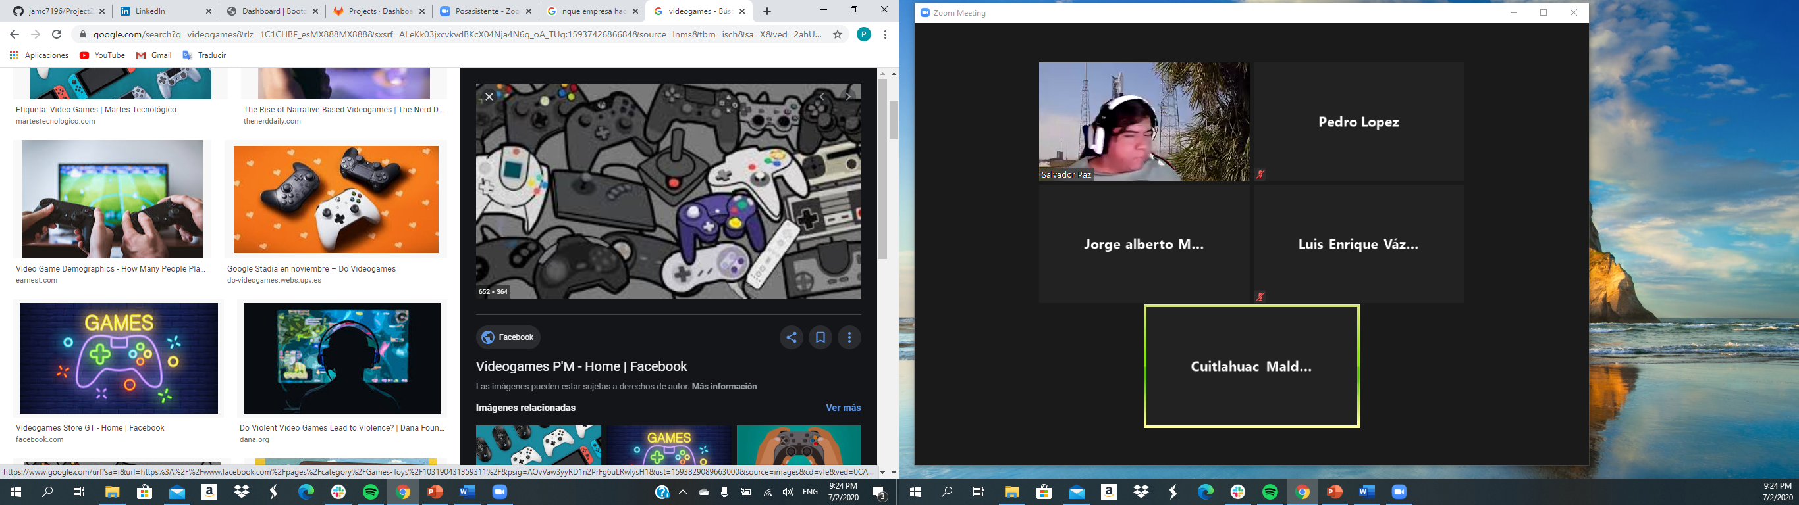
Associates:
Jorge Muñozcano Castro
Cuitlahuac Maldonado
Luis Vazquez
Pedro Lopez

Slide 2




We are a consultancy company which has been asked to advise a new video game producer BestVGS Cia. Ltd. which specializes in making a videogame.
They have been proposed to associate with one of these amazing Brands:
They need to give them all the insight that can help them to take the best decision according to their interests which primarily are:
Become globally recognized.
Increase the net worth and sales of the company.

Slide 3
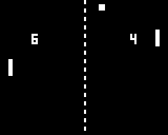
Premises
1) Is there any relation between genre and console?
2) Which company fits the best with our client’s interests?
3) In which region they should launch their first associated product?
4) Which company we recommend to sign the association?

Slide 4
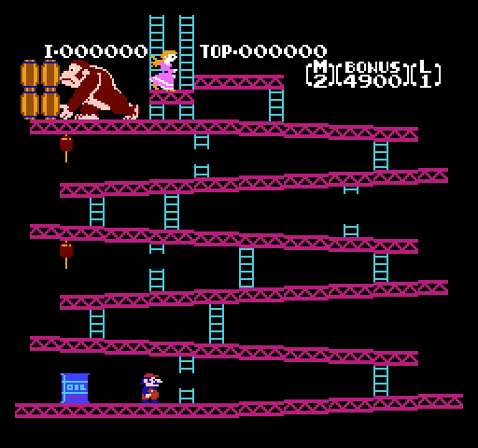
Methodology:
Exploration:
Kaggle.com
Rapidapi.com
Vizualization:
HTML/CSS
Javascript
D3
Plotly
Transformation
Flask
Python
Loading
MongoDB
PostgreSQL

Slide 5


Vizualization
START THE GAME

Slide 6

Insights:

Slide 7




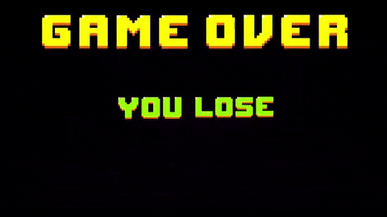
Recomendations:
PLAYSTATION
North America &Europe
Action Game

Slide 8

Thanks for your confidence in choosing us!

